Slide 1
Lecture Five
The State of Things

Slide 2
Critical Infrastructure?
Is space critical infrastructure?
GPS?
Comms?
Its all about time.
Does it need to be to drive policy?
It should be next year (in the US)
Until that happens…no DHs / CISA focus

Slide 3




Hosted Payload Providers

Slide 4







Bus Vendors
AIRBUS
Blue Canyon
Honeywell
Lockheed Martin
Loft Orbital
Northrop Grumman
Thales

Slide 5





Launch Vendors
Arianespace
Blue Origin
Rocket Lab
SpaceX
United Launch Alliance

Slide 6

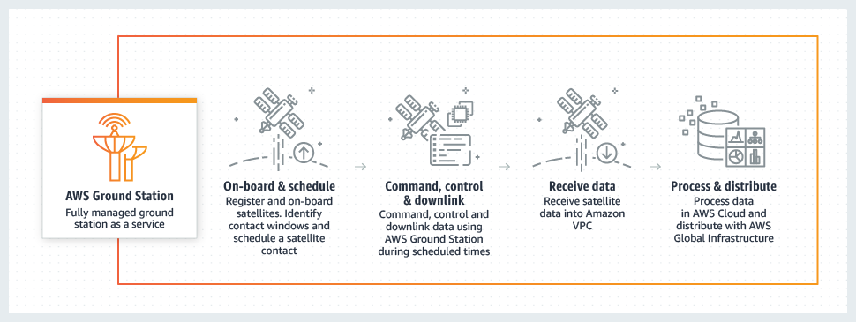

GSaaS & GEPs
Ground Station as a Service & Ground Entry Point Vendors
Satellite As A Service - AWS Ground Station
Azure Orbital Ground Station as Service
KSAT Global Ground Station Network

Slide 7
Non-Cyber Concerns
OSINT Satellite Tracking
Lasers
Missiles

Slide 8
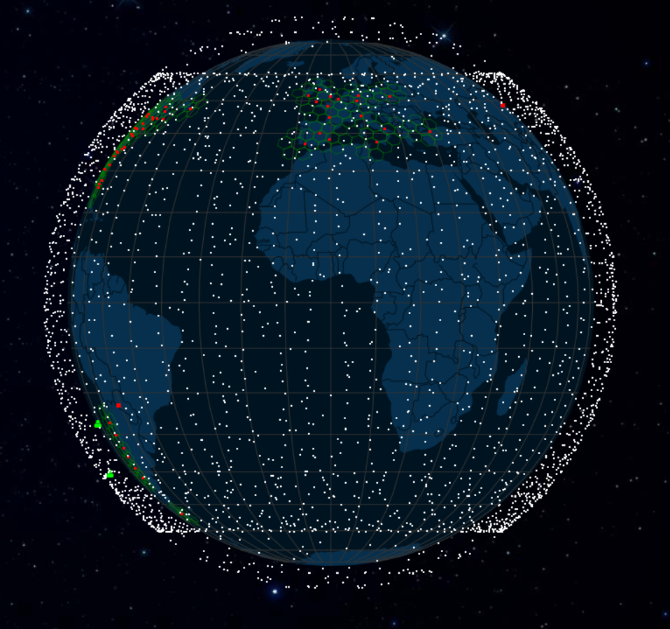
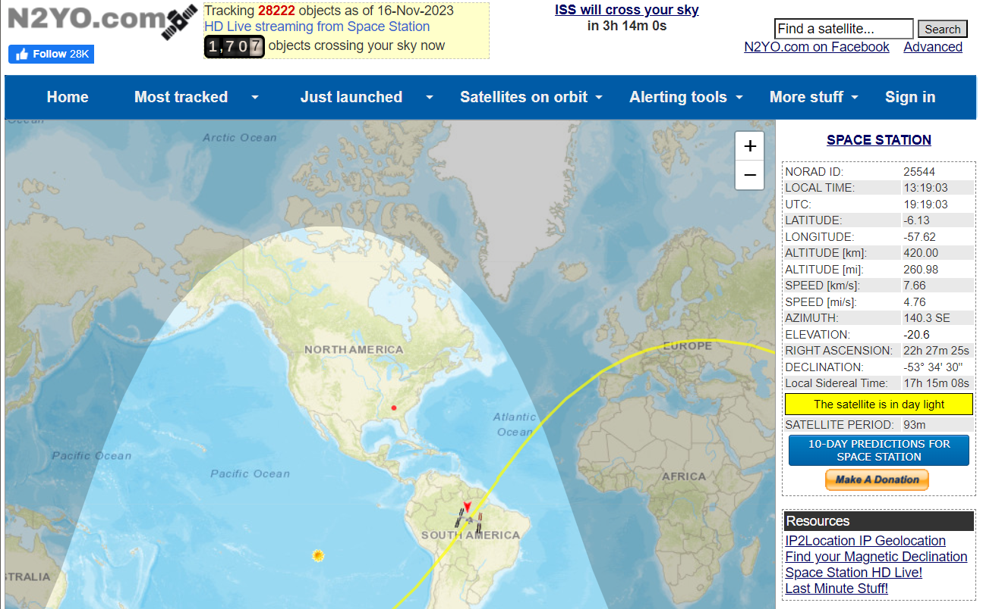
OSINT Satellite Tracking
https://satellitemap.space/ https://www.n2yo.com/

Slide 9

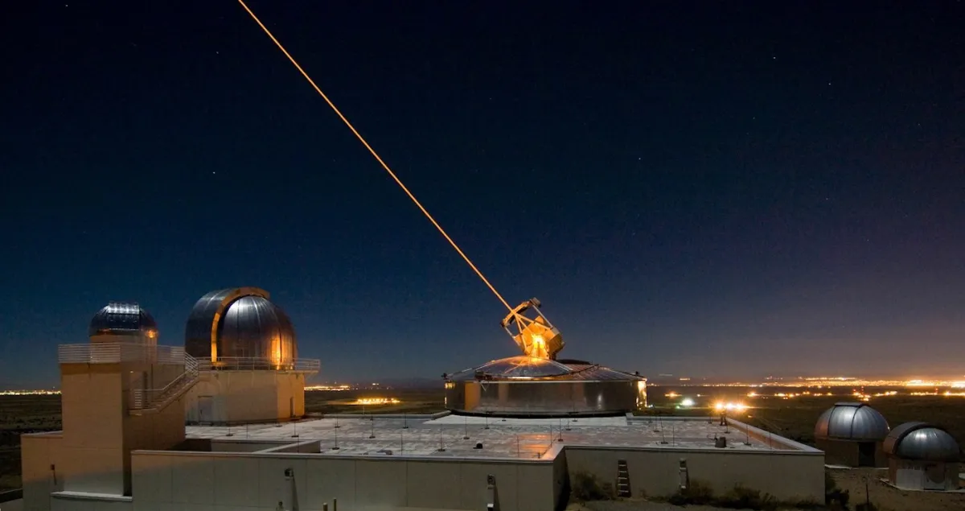
Lasers
US Army successfully tested the TRW-built Mid-Infrared Advanced Chemical Laser (MIRACL) at the White Sands Missile Range, New Mexico, on 17 October, 1997
https://www.flightglobal.com/anti-satellite-laser-test-is-successful/17857.article
Russia and China are attacking US satellites with lasers
https://www.independent.co.uk/space/russia-china-attack-us-satellites-lasers-b1972406.html

Slide 10



Guidance / Standards / Policy
Standard software: NASA Core Flight Executive (cFE), COSMOS, CESIUM
NIST – system overlays
IEEE - secure by design pinciples
CCSDS – Architecture framework for space system design

Slide 11
Law and Regulation
International Heritage Laws
The Outer Space Treaty
The Rescue Agreement
The Moon Agreement
The Liability Convention
The Registration Convention
National Information Assurance Policy for Space Systems Used to Support National Security Missions - CNSS 2012
National Space Policy Directive 5 – Whitehouse 2020
NIST Satellite Ground Segment: Applying the Cybersecurity Framework to Assure Satellite Command and Control – NIST 2022
IEEE Standards Association's Space System Cybersecurity Working Group (S2C WG)

Slide 12
Academia / Resource Organizations
Capitol University - PhD in Space Cybersecurity
Embry-Riddle – Bachelors in Space Operations
John Hopkins Engineering – Space Systems Cybersecurity Course
Cornell – Space cybersecurity programs being developed and courses taught
Space ISAC
Aerospace Corp Aerospace.org / SPARTA
NASA
The Aerospace Village
HackSpaceCon
CyberSatGov

Slide 13

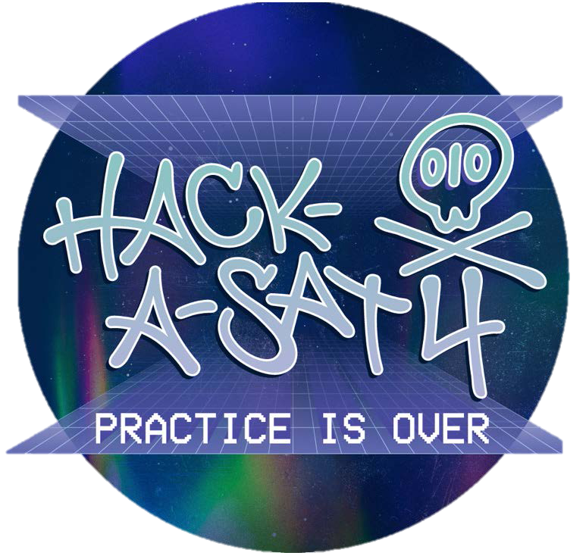
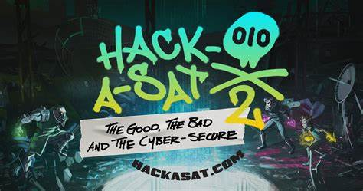

Hack-a-Sat
Hack-a-Sat is a CFT style compotation funded by the United States Department of Defense.
It consists of a thirty-hour qualifying round and a final competition that takes place yearly at Las Vegas during DEFCON. The top eight teams receive $10,000 each.
To receive qualification event cash prizes, the top eight teams must submit technical papers to describe how they hacked the satellite.
Winning teams take home prize money in the ranges of $20,000-$50,0000.
To take home prize money, a technical paper must be submitted to describe the entire approach to winning the game.

Slide 14
Customer Base
Military
Intelligence
Other government (weather for instance)
Commercial
Space-based services
Space as a Service
Hosted payloads
Satellite builders / operators

Slide 15
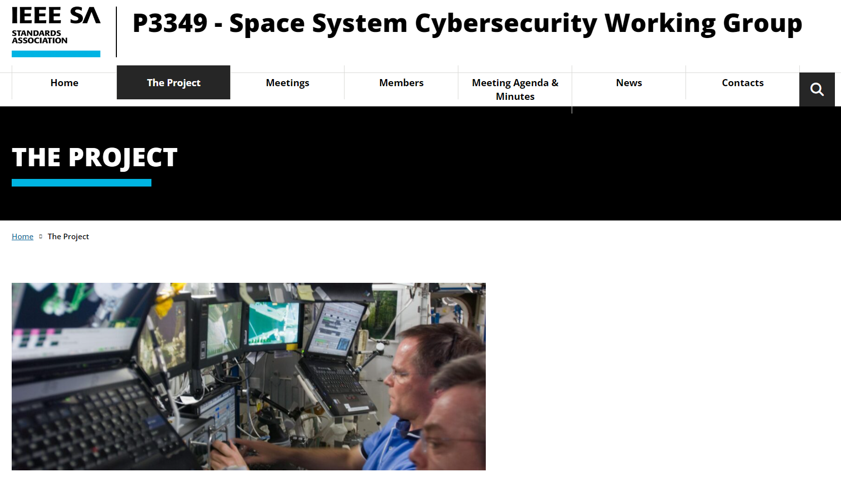
https://sagroups.ieee.org/3349/the-project/

Slide 16
The IEEE Effort
Intention: Secure by design
Based on security design principles, not technical implementations
CCSDS & architectural concerns vs IEEE
Not a regulation or standard but an international guideline
Papers
Minimum Requirements for Space SystemCybersecurity - Ensuring Cyber Access to Space
Secure-by-component: A System-of-systems Design Paradigm for Securing Space Missions

Slide 17
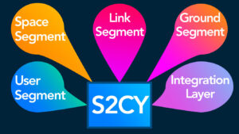
The IEEE Effort
Ground segment
Link segment
Space segment
User segment
Integration segment

Slide 18
From CISA Recommendations to Space System Operators for Improving Cybersecurity

Slide 19
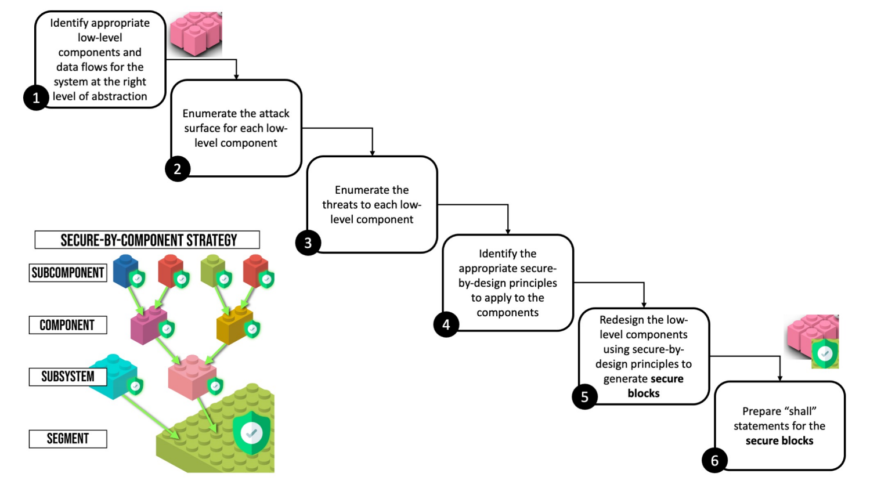
The IEEE Effort

Slide 20
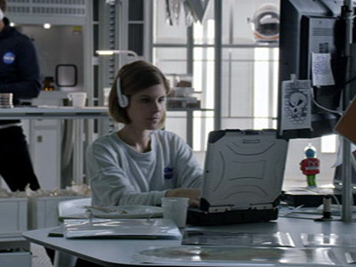
Rich Purnell Maneuver
Misnamed file bypasses security filters
Hides from people noticing

Slide 21
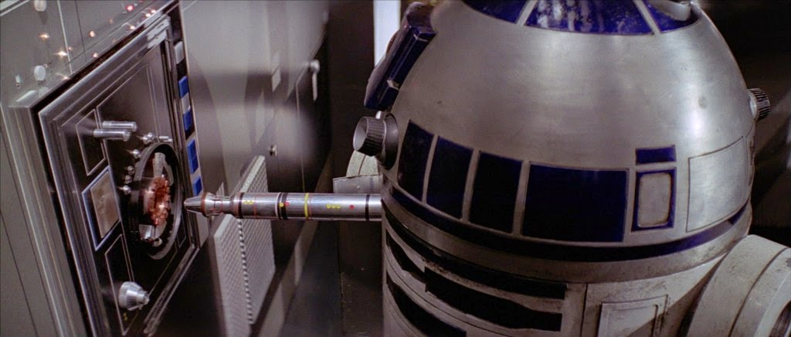
Beep boop

Slide 22
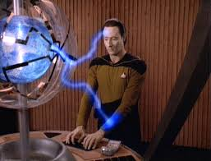
Star Trek TNG Contagion
Responds to a SOS
Finds a partially destroyed ship and a disabled enemy ship
Downloads ships log from damaged ship
Starts having malfunctions
Determine that a probe from a long gone but very advanced civilization scanned and began reprogramming the damaged ship’s computer and the enemy computer in its own image
May seem ridiculous but….FPGA’s are a thing
And post quantum compute makes brute force probably trivial

